Slide 1

Project presentation
WEB DEVELOPMENT II
Tamara Plante | Dong Huang | Iana Setrakova

Slide 2
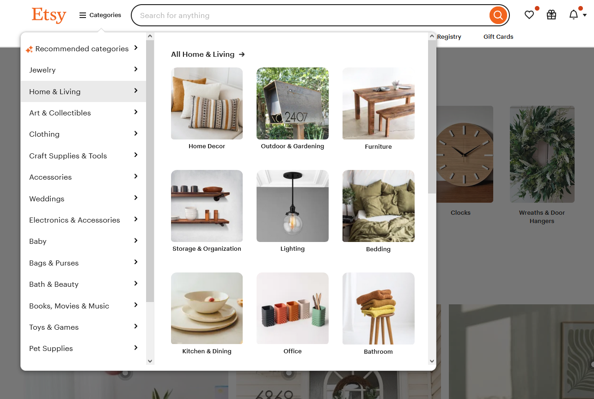

Project Purpose
Marketplace for Unique Products
• Connect Creators and Shoppers
• Easy Browsing
• Enhance the Shopping Experience

Slide 3
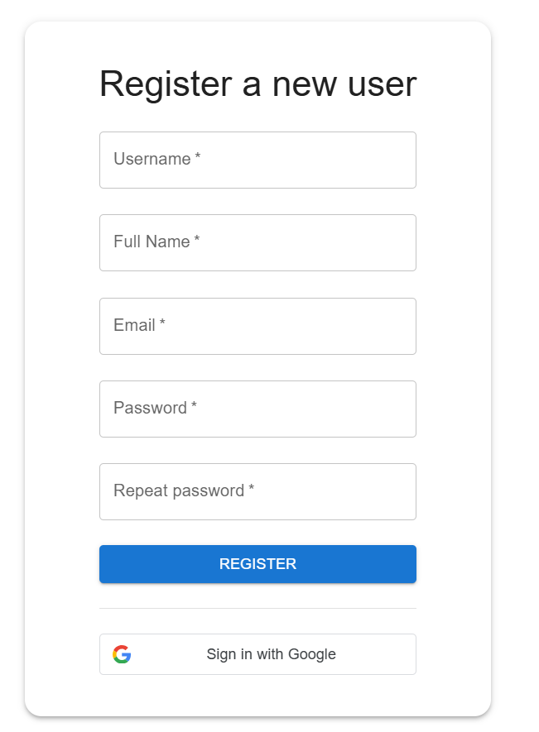
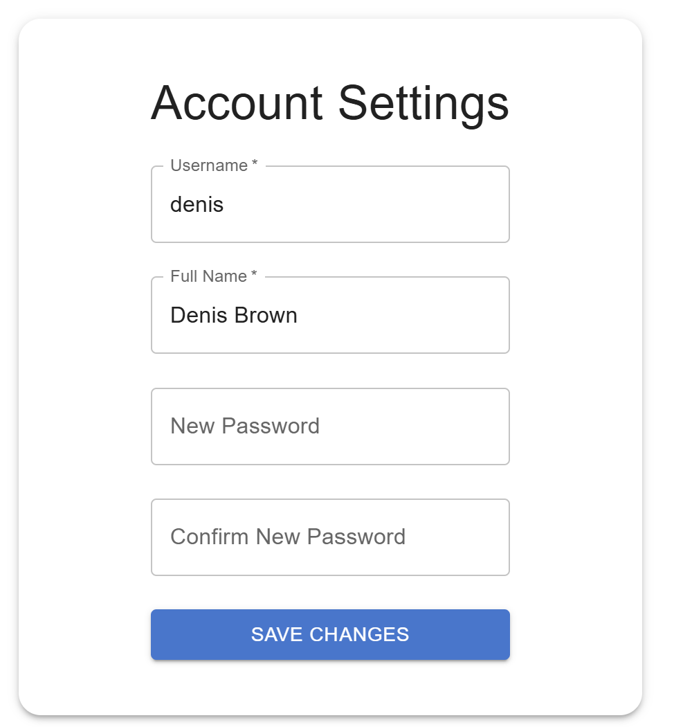
Project solution
Features and Functionalities
• Google Sign-In Authentication
• Use @react-oauth/google
• Allow the same users to log in with google or password via email

Slide 4
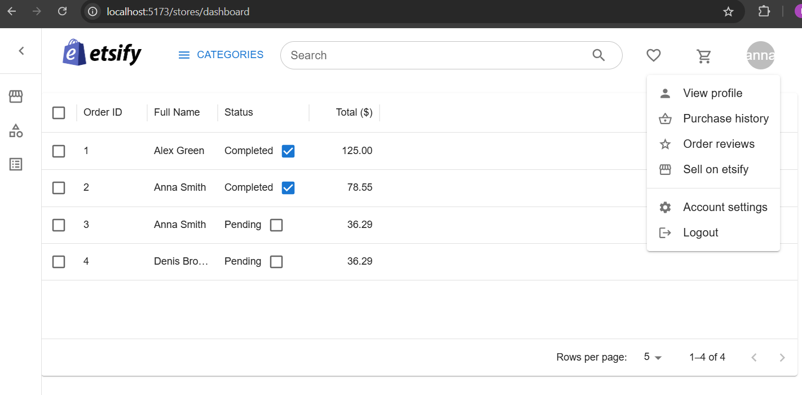
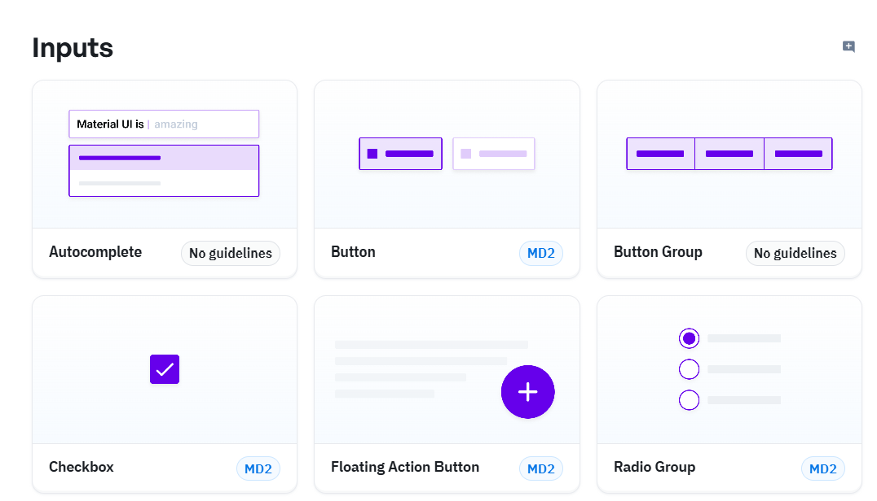
Project solution
Features and Functionalities
• Material UI

Slide 5
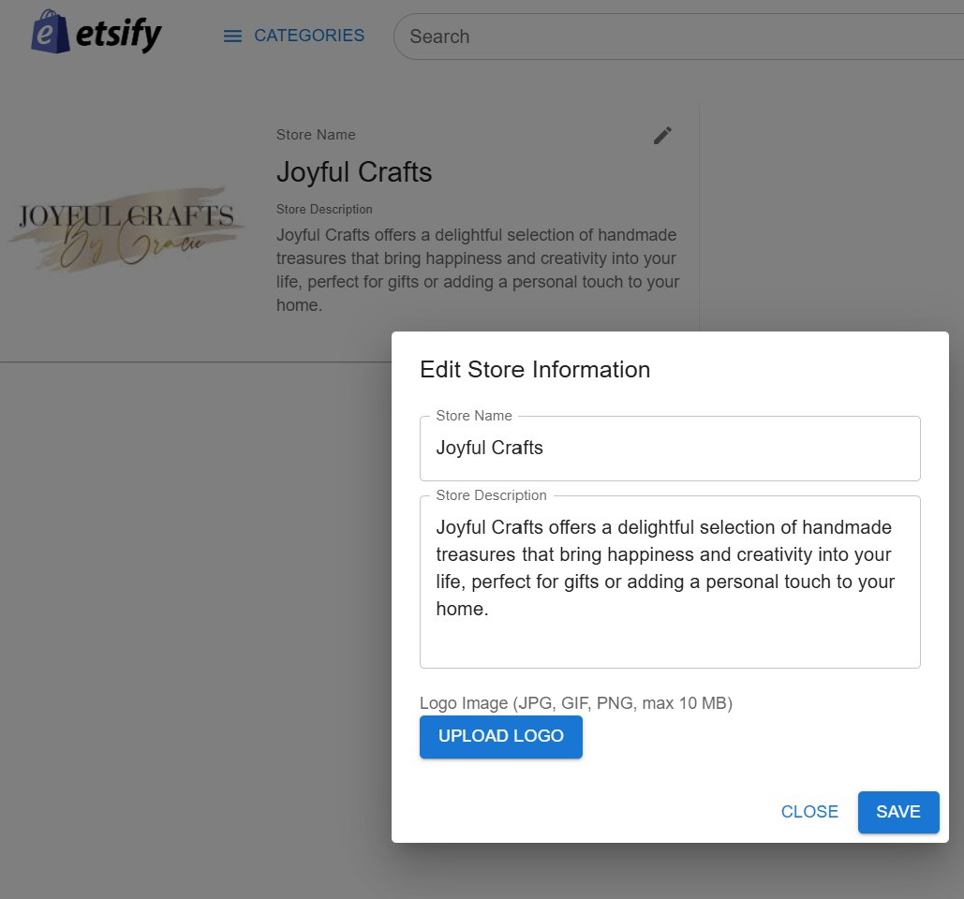
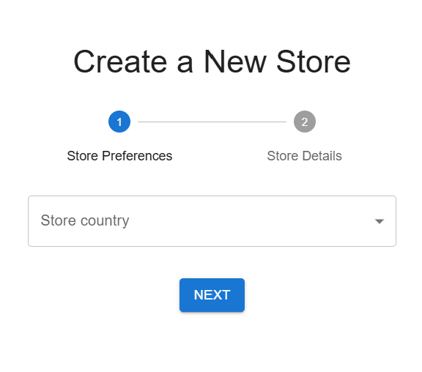
Project solution
Features and Functionalities
• Dashboard
- Managing store information

Slide 6
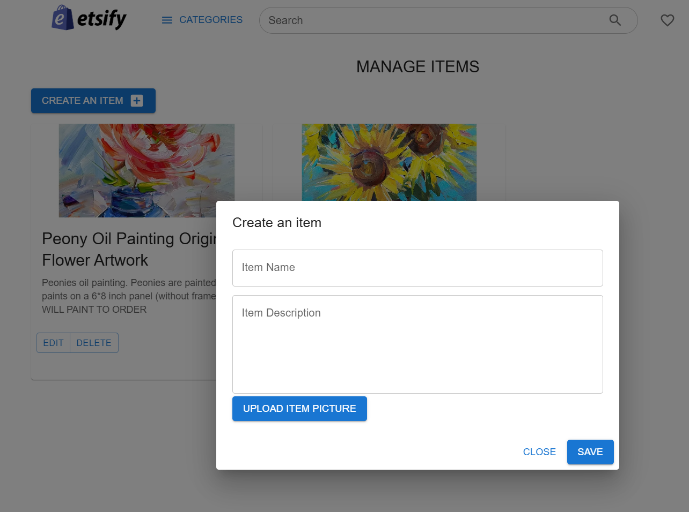
Project solution
Features and Functionalities
• Dashboard
- Managing items

Slide 7
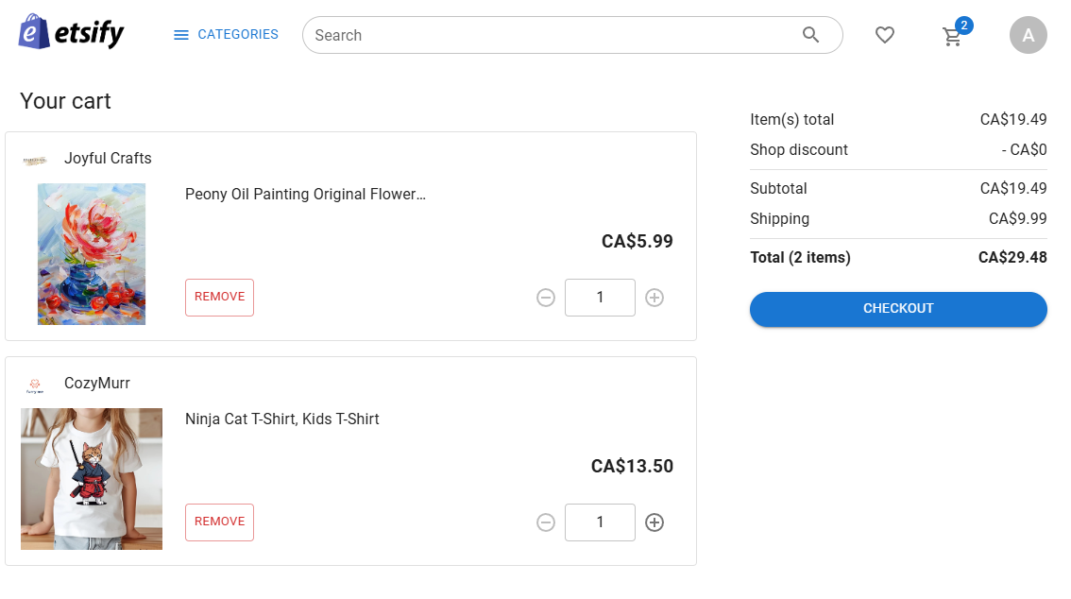
Project solution
Features and Functionalities
Cart view with a cart badge

Slide 8
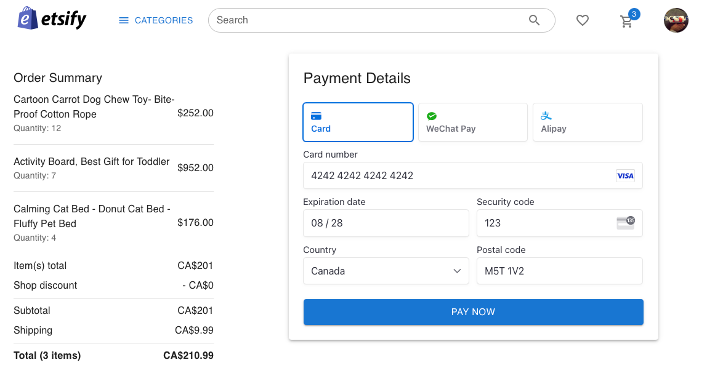
Project solution
Features and Functionalities
• Stripe payment enabled

Slide 9
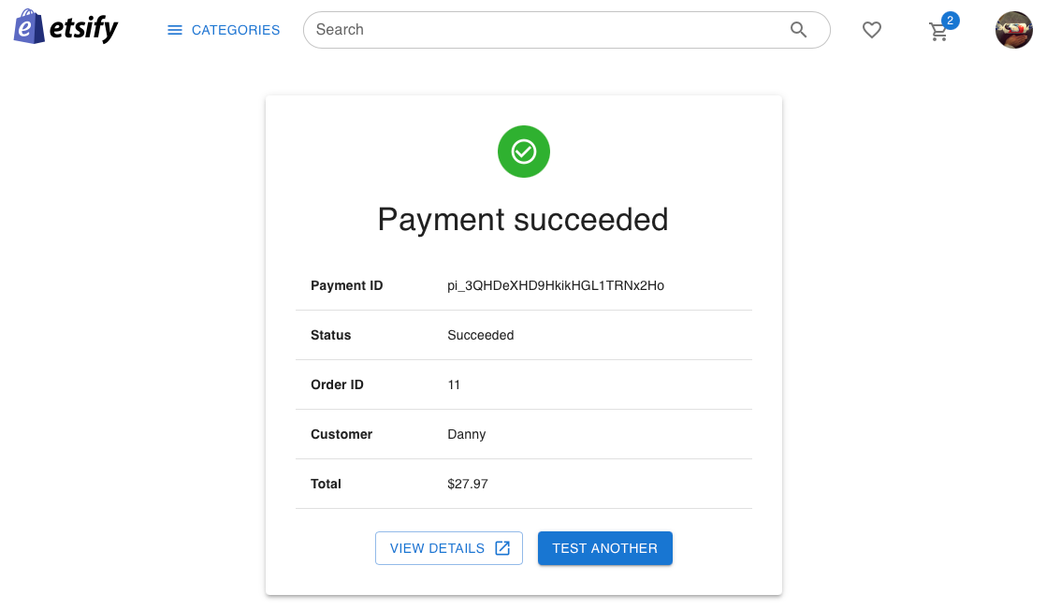
Project solution
Features and Functionalities
• Cart checkout

Slide 10
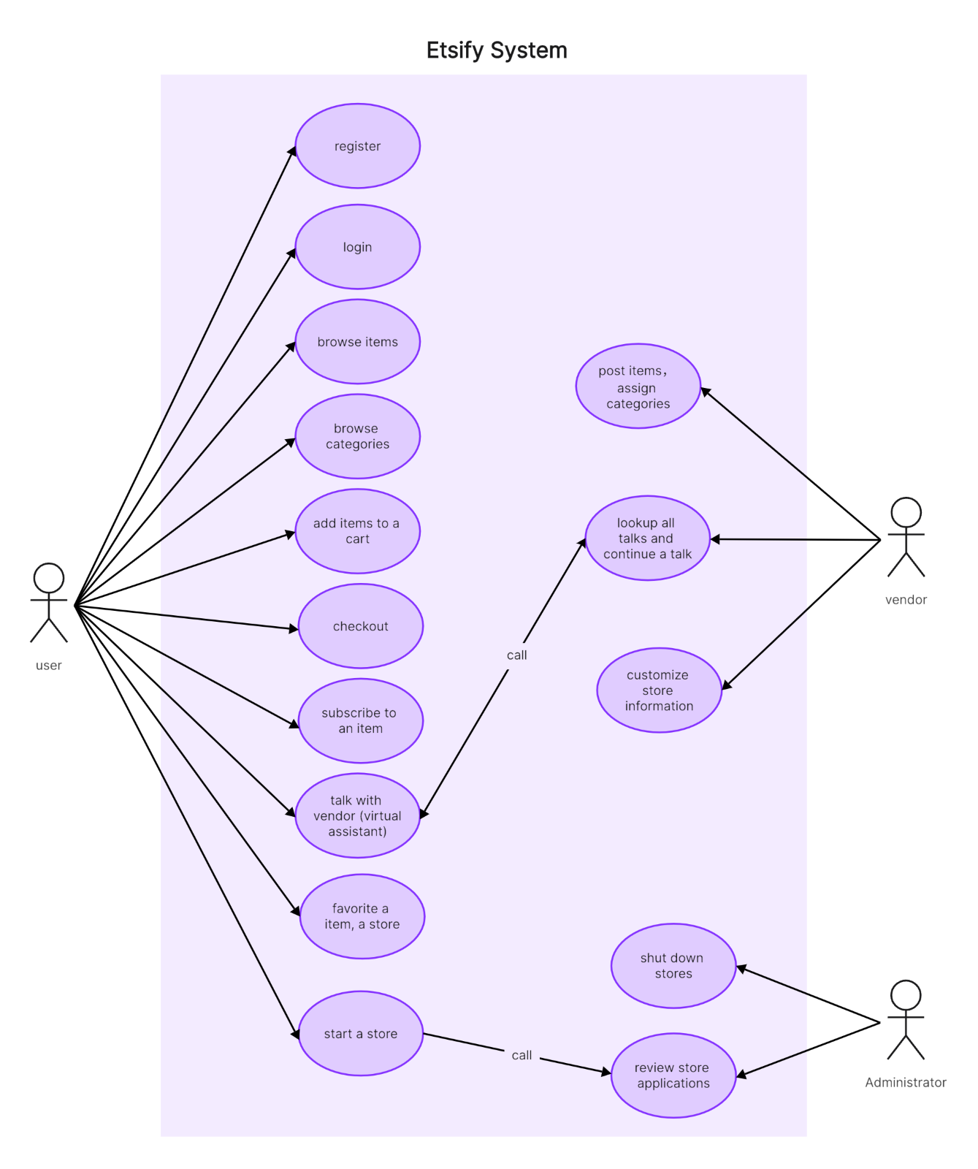
Project solution
USE CASE DIAGRAM
• User
• Vendor
• Administrator

Slide 11
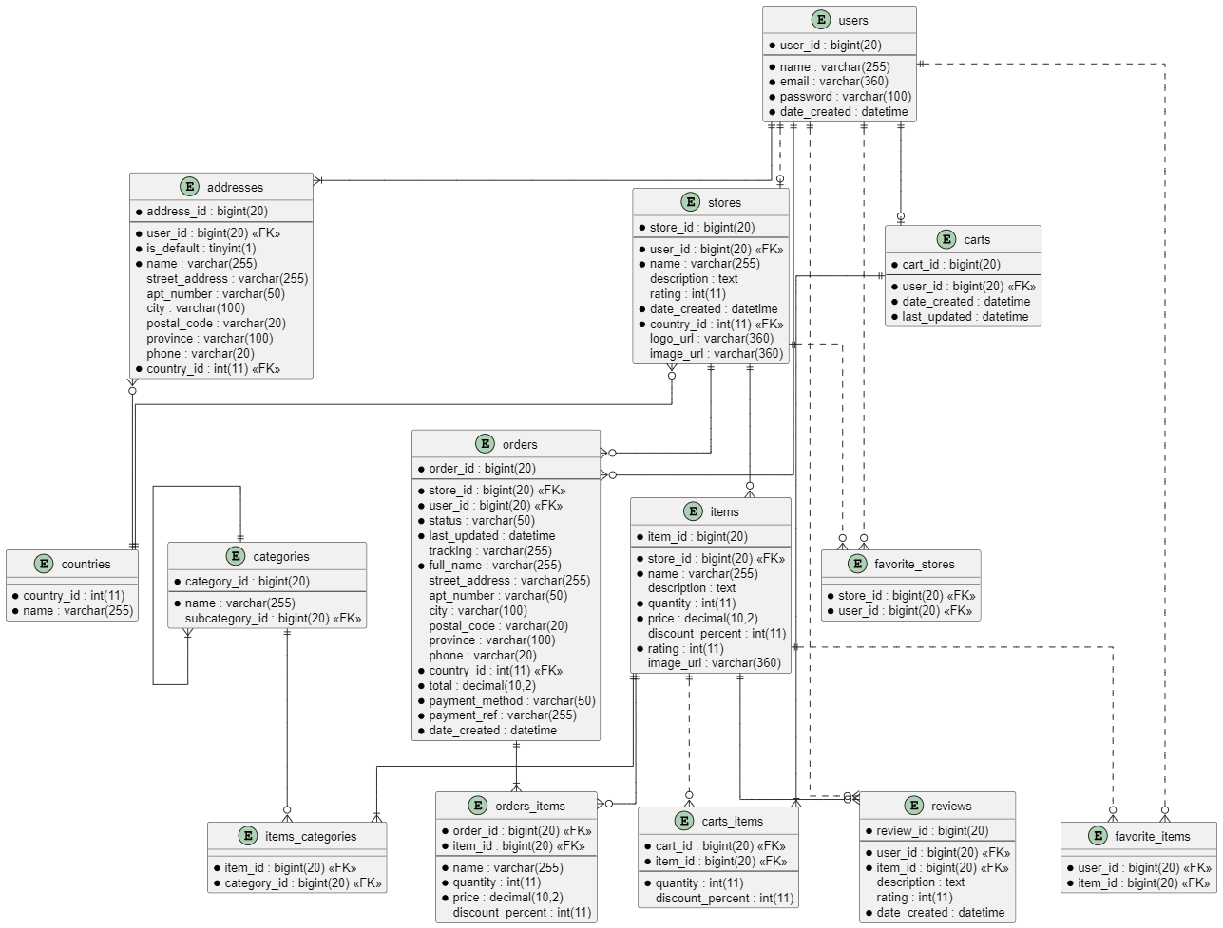
Project solution
E/R DIAGRAM
Using Sequelize

Slide 12
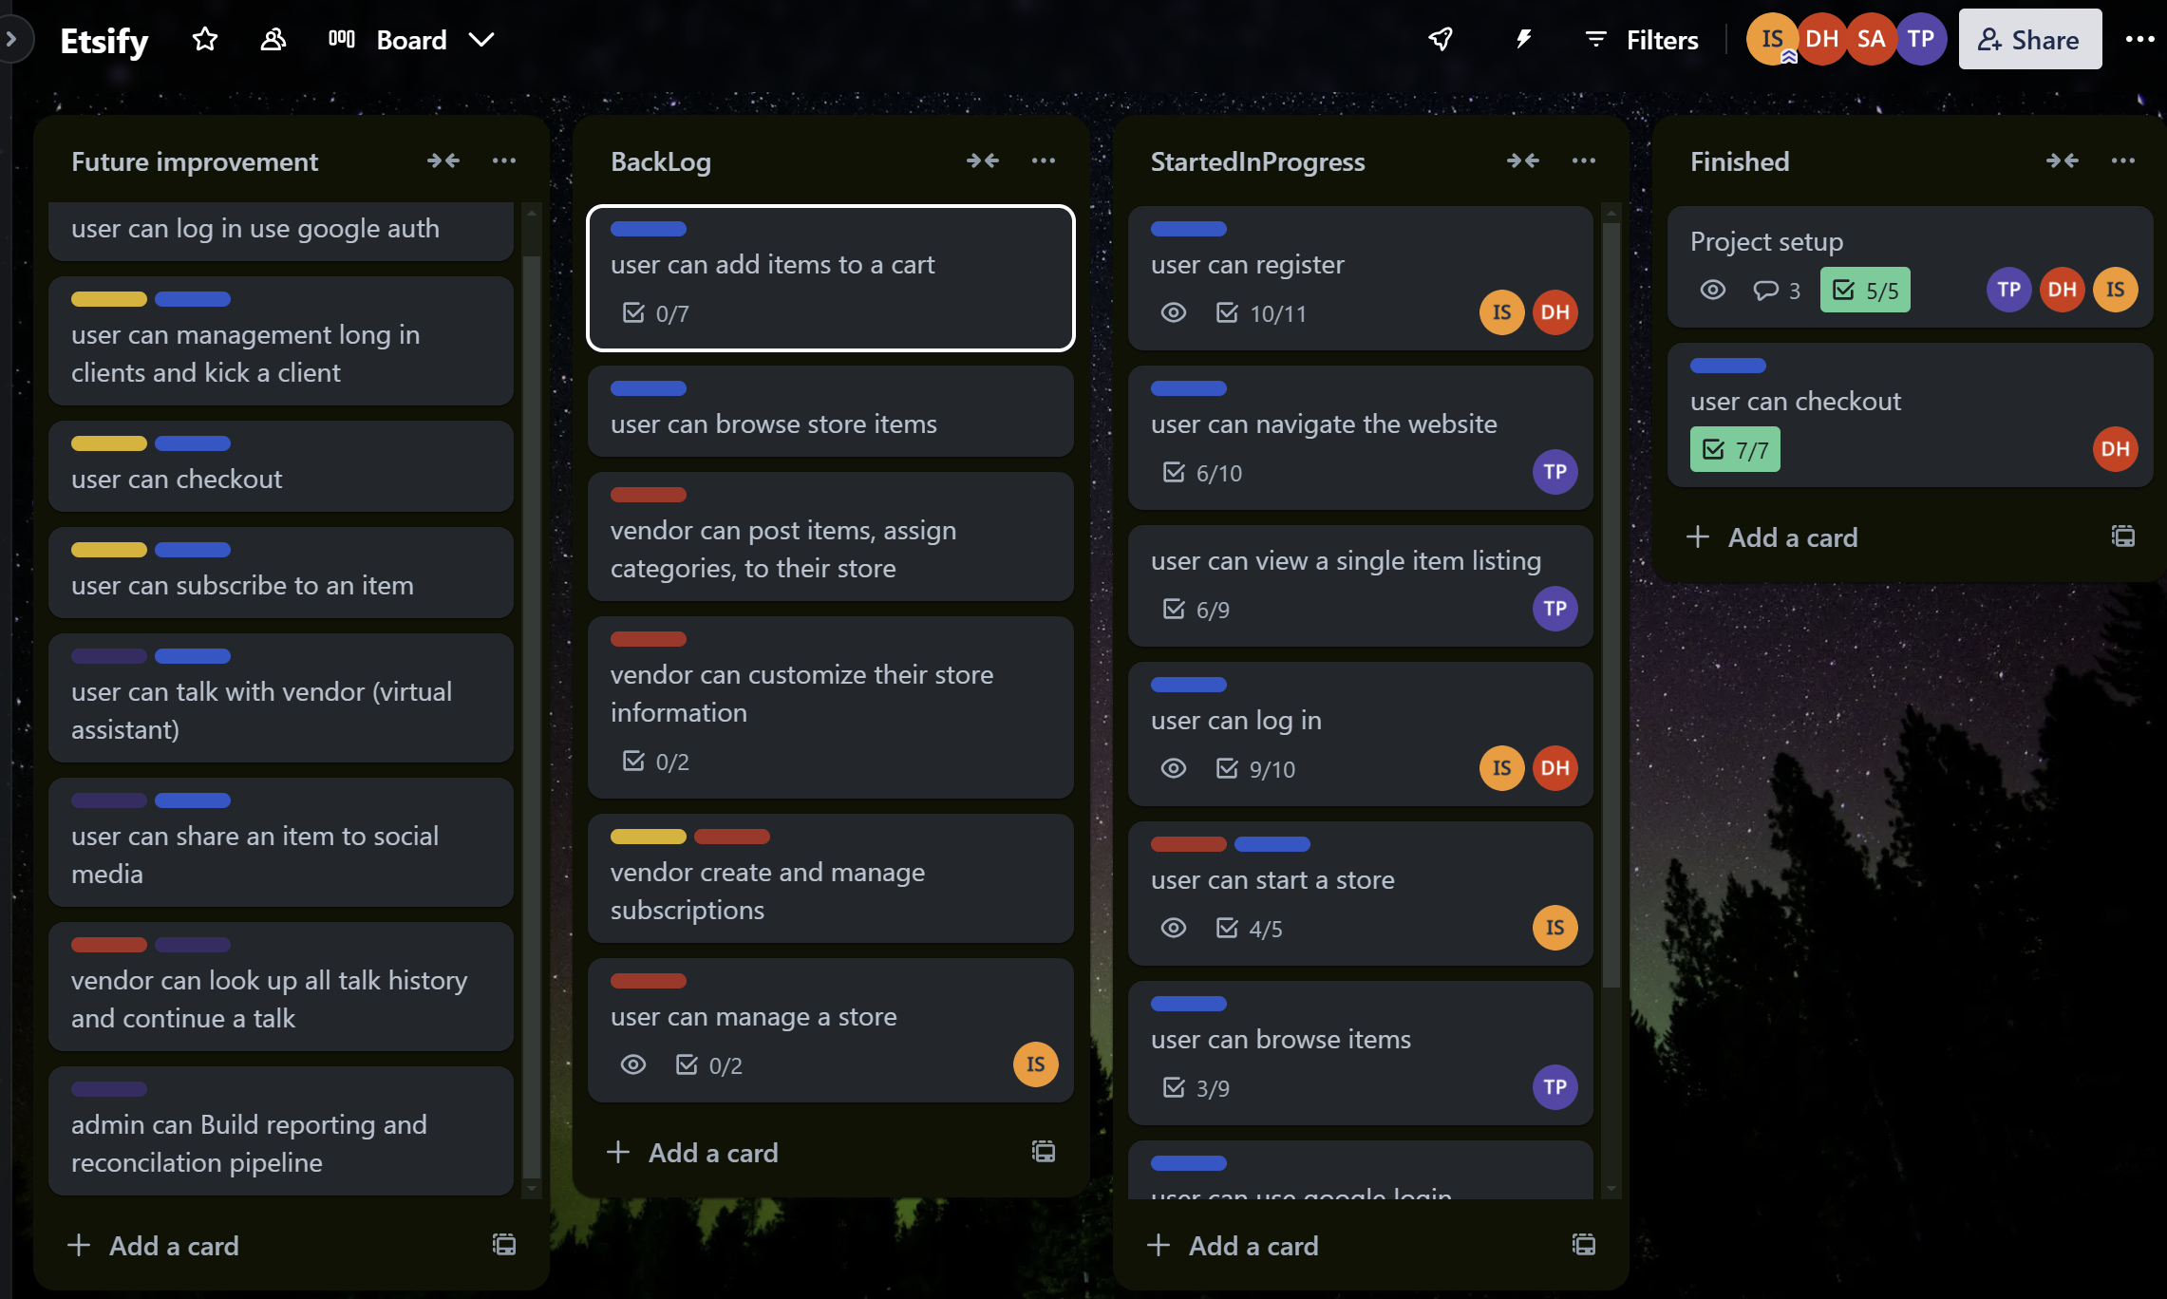
Project solution
TRELLO

Slide 13
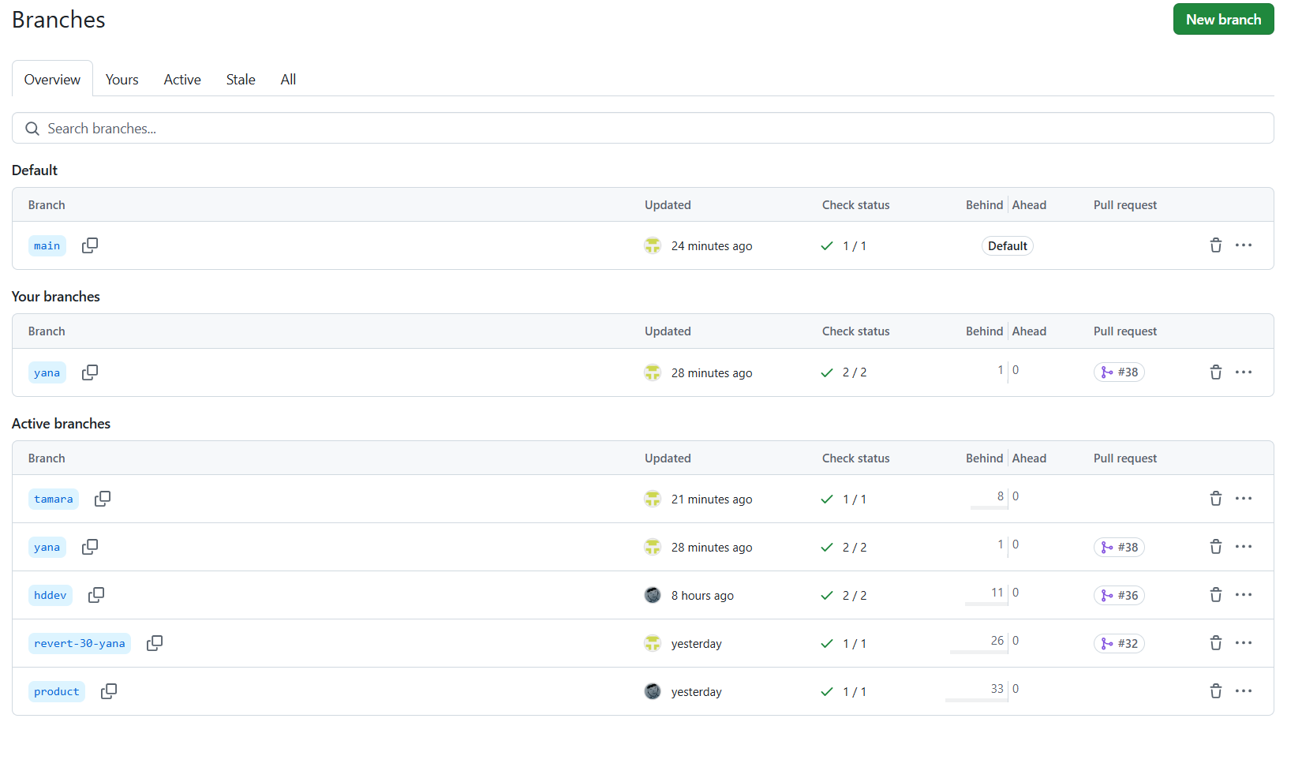
Project solution
GITHUB
• 2 Projects
• Individual branches
• Product (special)

Slide 14
Project solution
Technologies and libraries:
• Vite React, Material UI
• Node.js, Express.js, Sequelize, Jest, supertest
• Cloudflare Pages(Web & CDN) & Heroku(API)
• Database AWS RDS MySQL
• Authentication: JWT
• Google Auth
• Storage: AWS S3
• zustand for State management

Slide 15
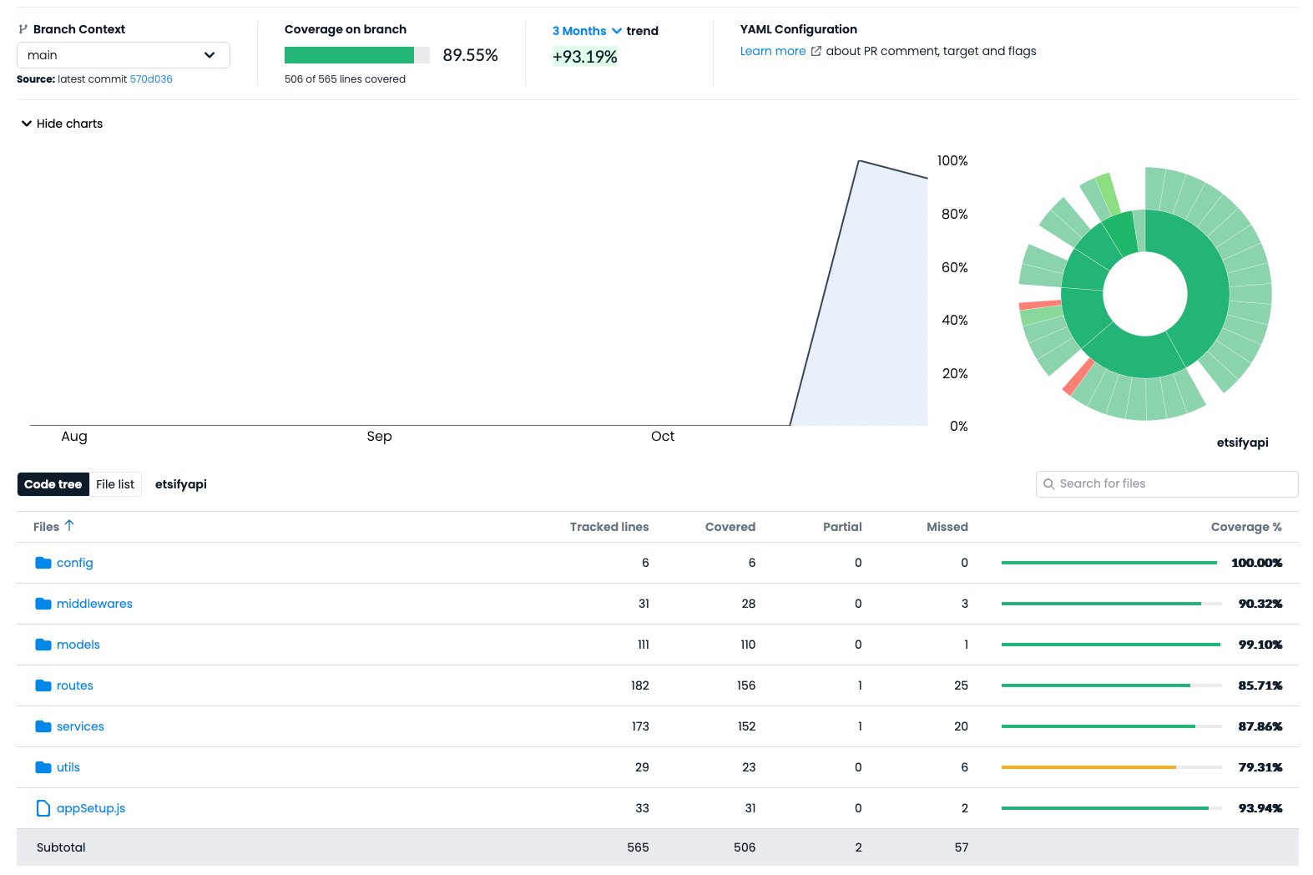
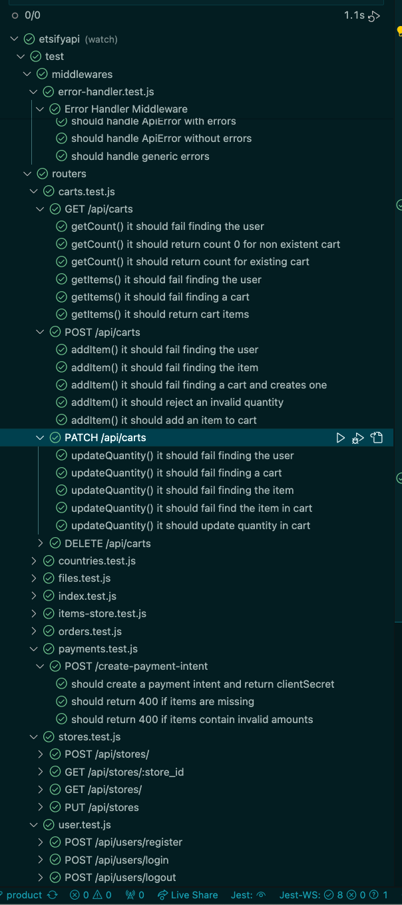
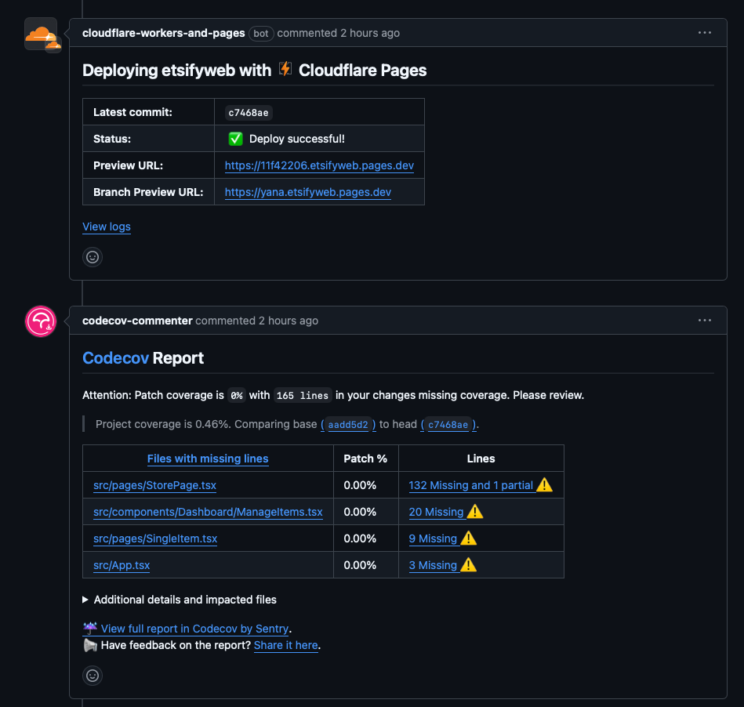
Challenges and solutions
• CI – GitHub workflow
• Code coverage
• Safe

Slide 16
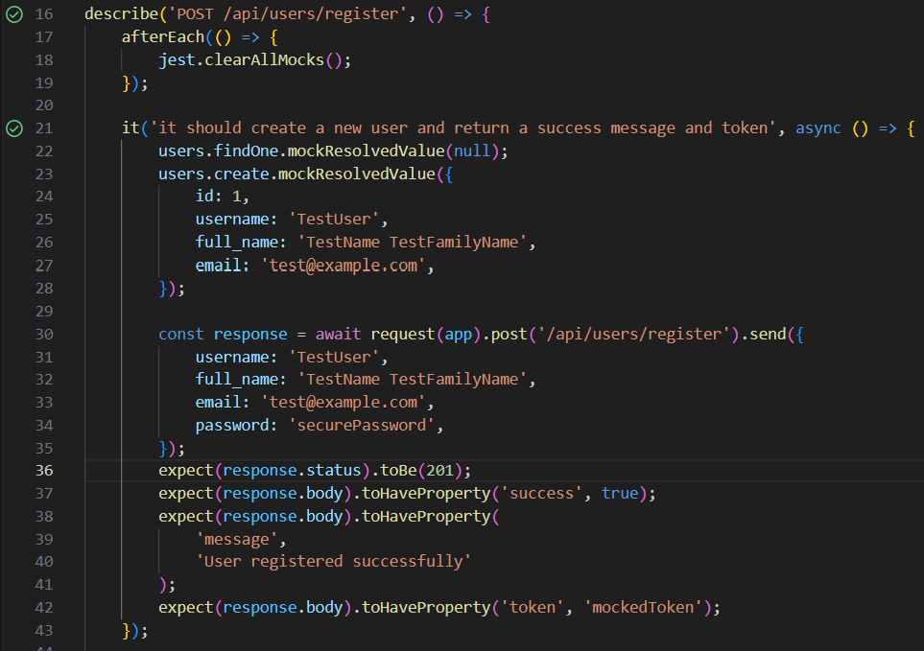
What we learned
Technologies:
jest Testing

Slide 17
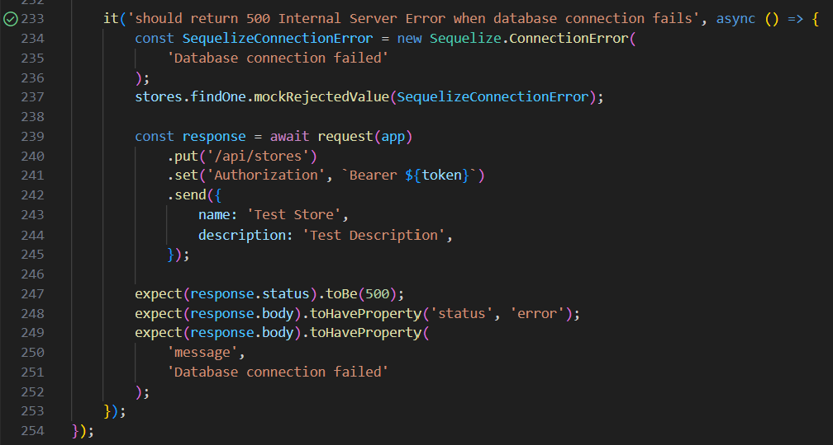
What we learned
Technologies:
jest Testing

Slide 18
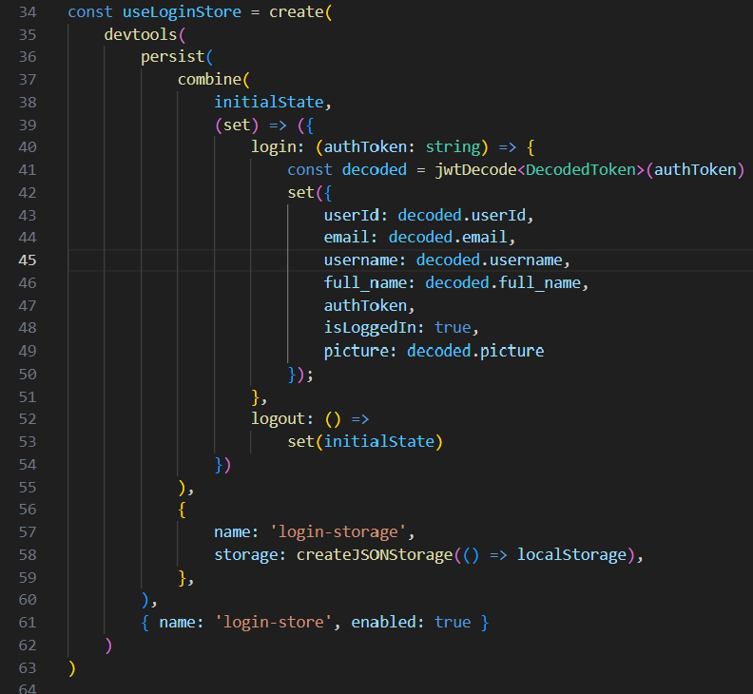
What we learned
Technologies:
zustand for State Management
Small, fast state management
Persist integration
Simple used in page by hook
Simple used in other hook by function

Slide 19
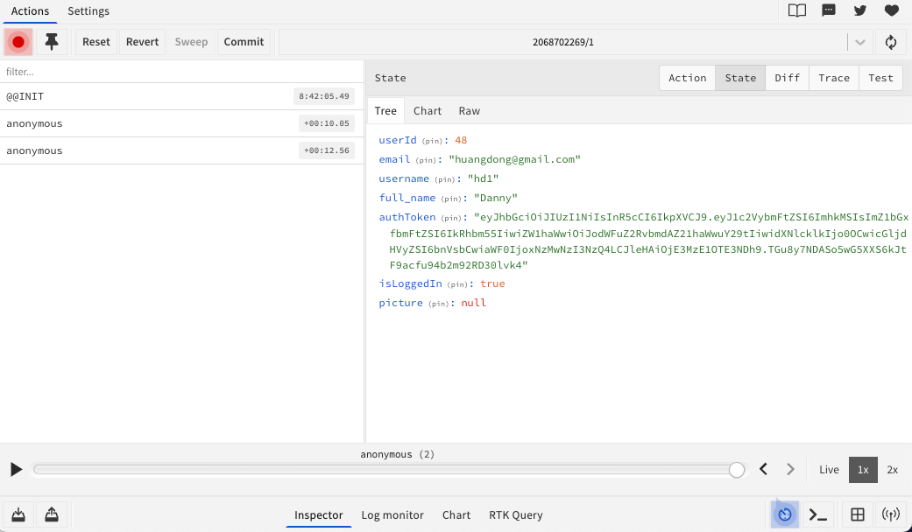
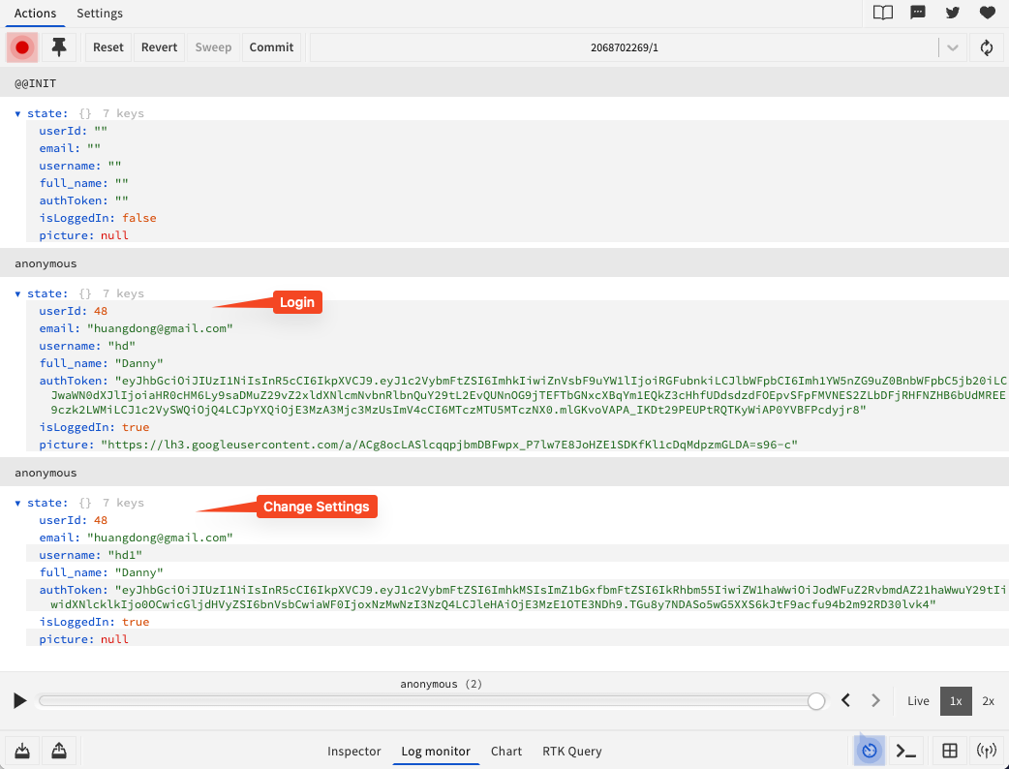
What we learned
Technologies:
zustand for State Management
Compatible with Redux development tools
View State in real time
State Change History
Playback of State changes

Slide 20
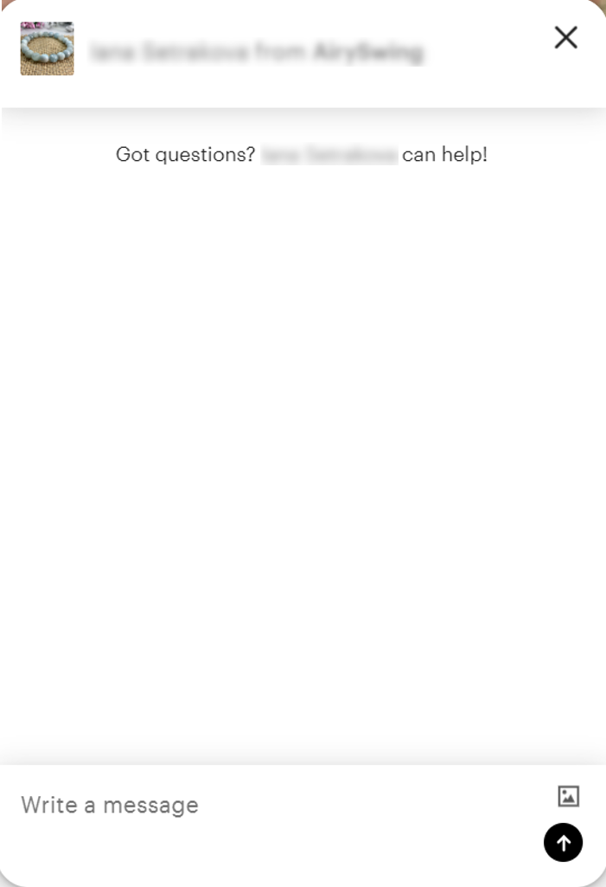
Future Work
Enabling a virtual assistant
Item subscription
Sharing items in social media
More complete search functionality
Browse by category
More tests for front-end and back-end

Slide 21
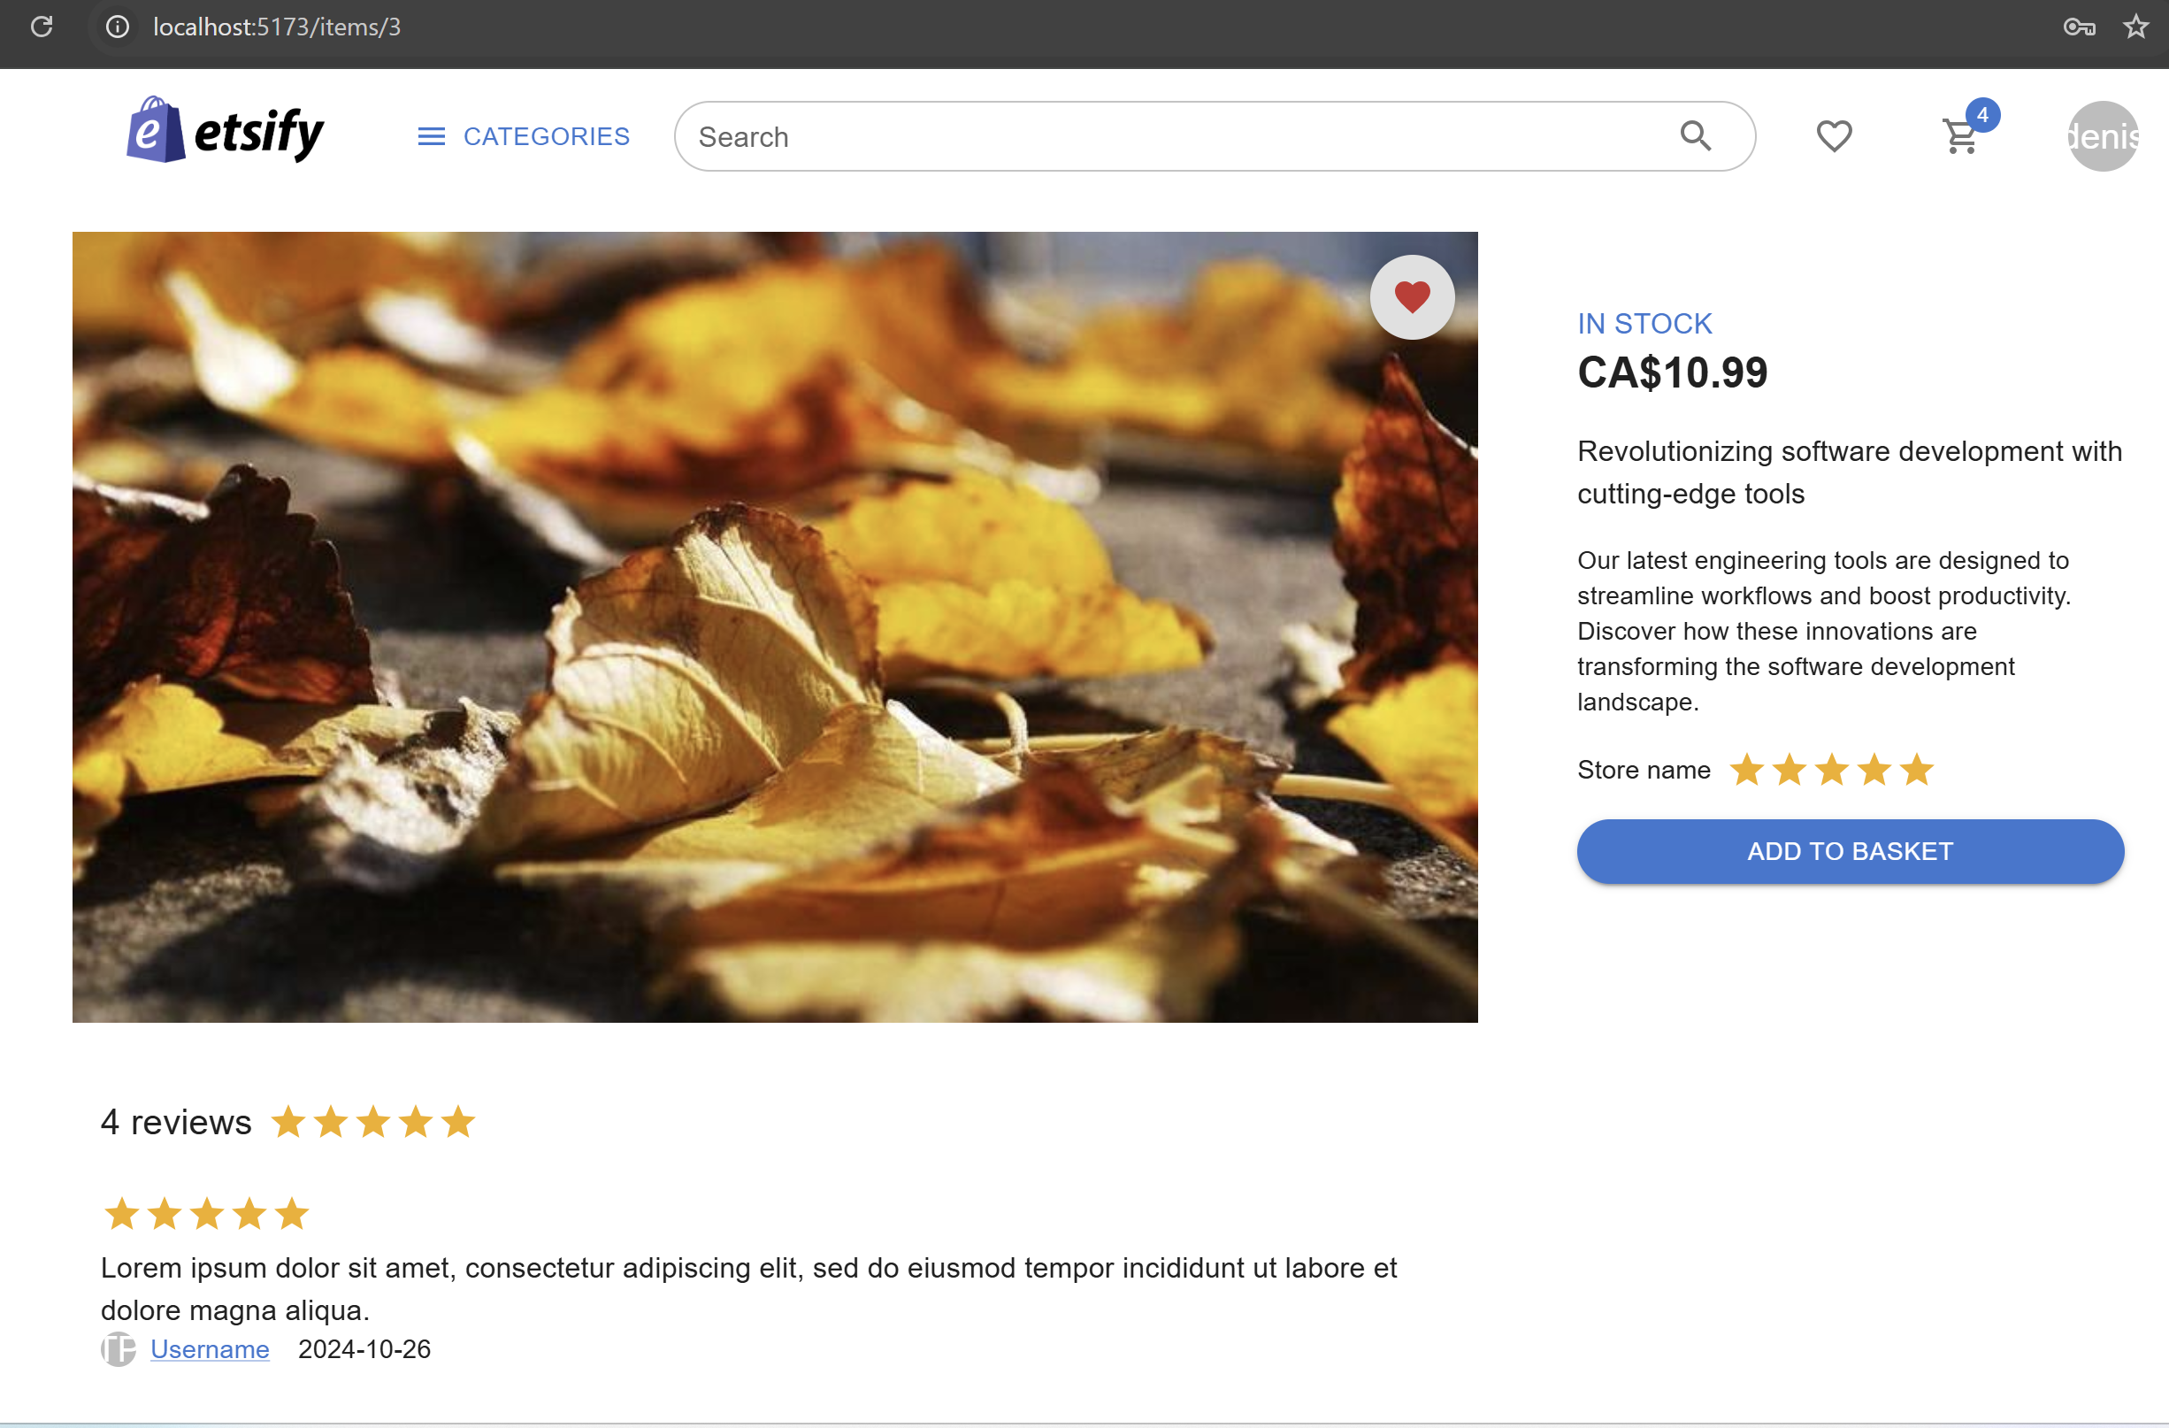
Summary
Fully functional Etsy clone with
creating stores and managing products
engaging between sellers and buyers
enjoying a seamless shopping experience

